Slide 1
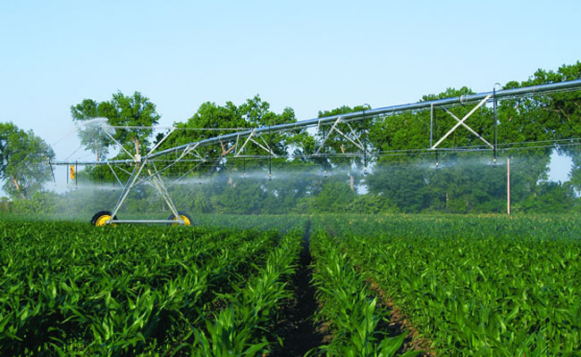
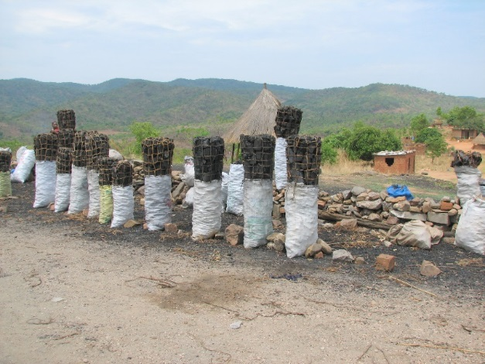
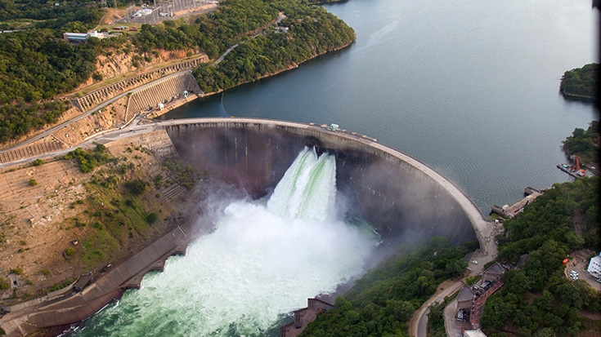
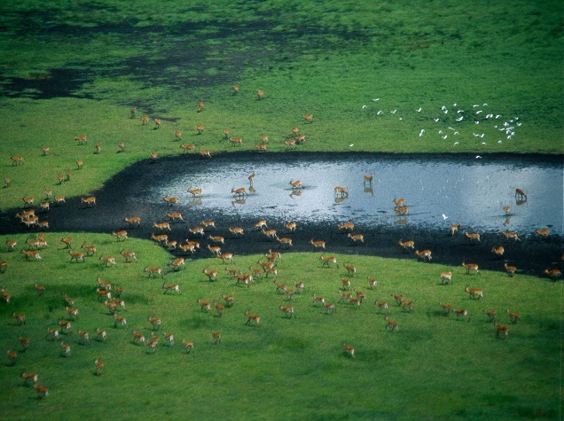
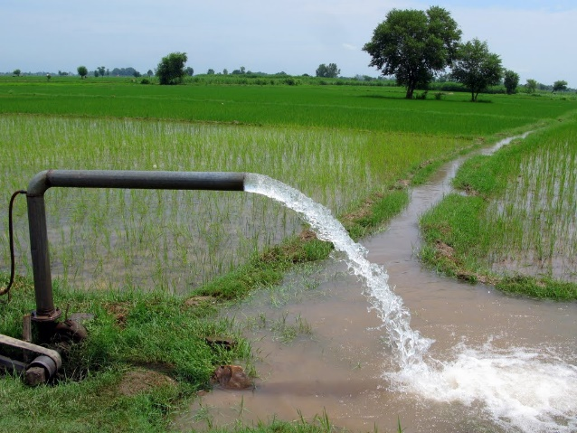
Exercise 6: Water cycles and signature
Peter Burek, Mikhail Smilovic, Luca Guillaumot
International Institute for Applied Systems Analysis
Research Scholars at
Water Program

Slide 2
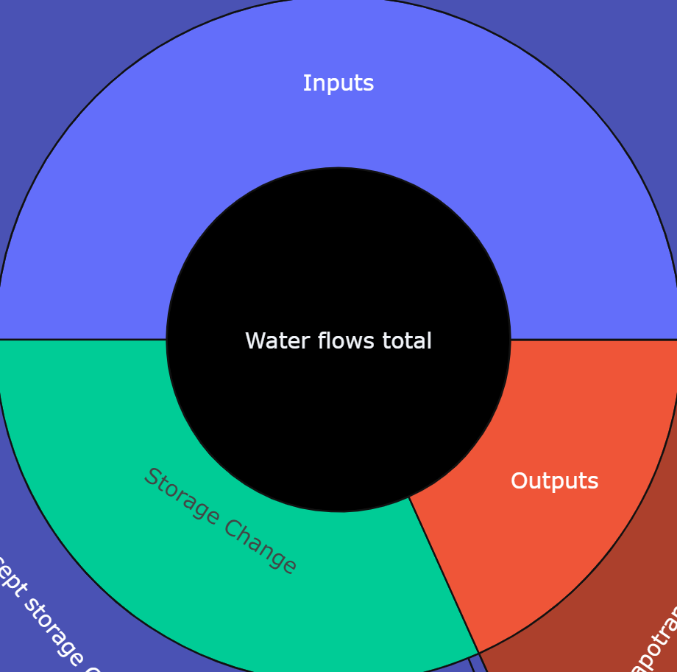
Water cycle
Inputs
A water balance is used to understand the flows through a system.
A water cycle/wheel/circle summarises the flows through a system over a certain period.
The inputs to the system equal the outputs from the system plus whatever changed in the system.
Inputs = Outputs + Storage change
Water flows through the system
Outputs
Storage Change
Notes:
The narrative as told through the water cycle, and the water balance

Slide 3
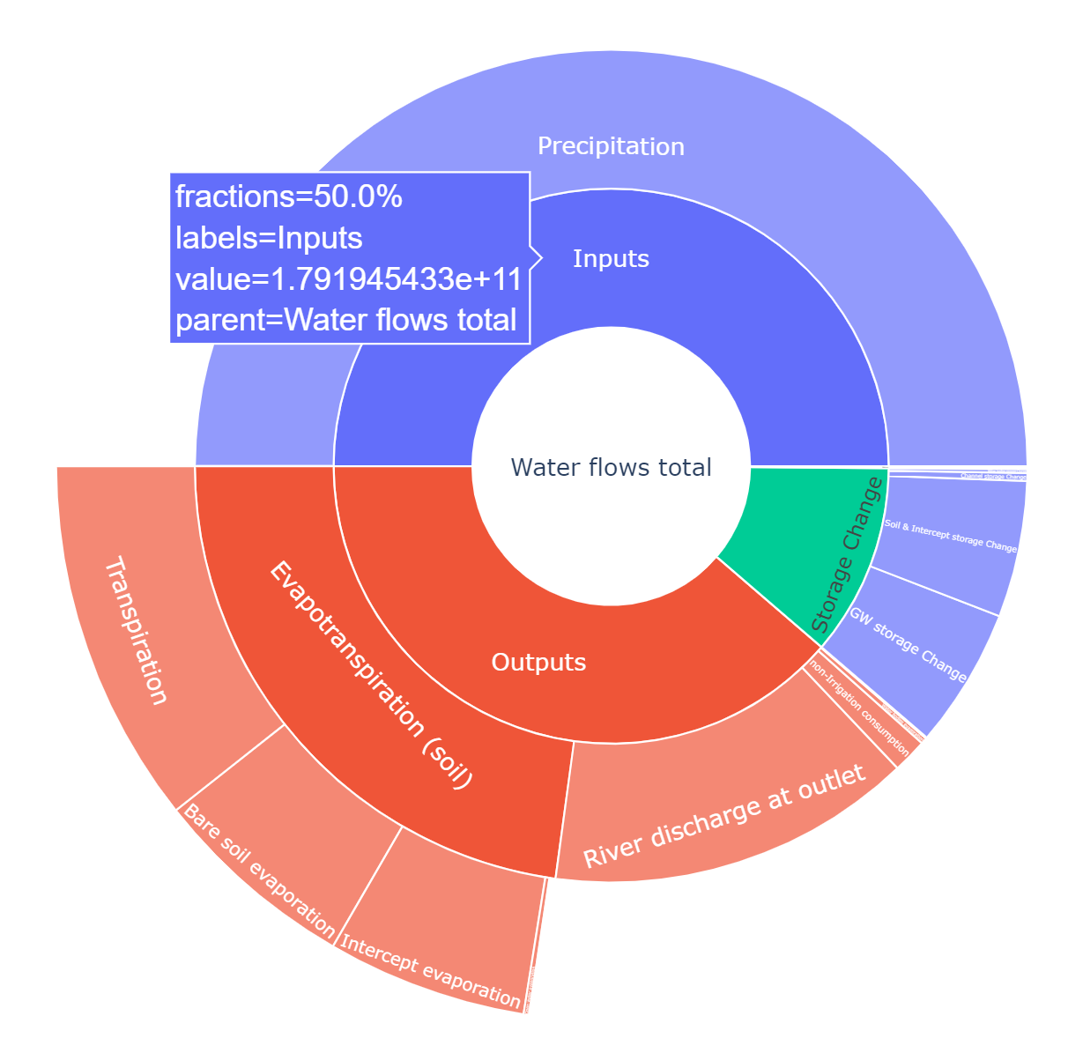
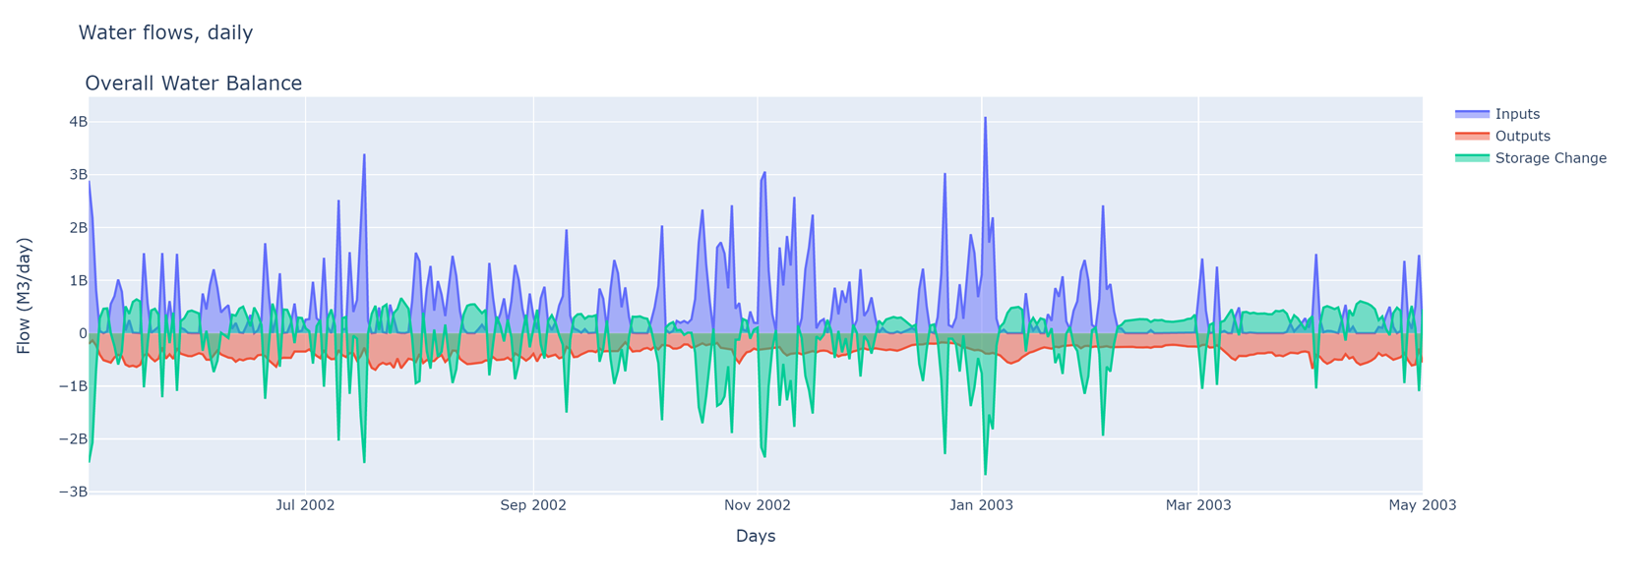
Water cycle and signature example
The Rhine basin for an example year

Slide 4

Water cycles and signature
Install Jupyter notebook
Open and execute WaterCycles.ipynb using Jupyter notebook
Play CWatM with specific outputs and for your coordinates
Execute WaterCycles.ipynb, updating the outputs path and basin outlet coordiantes
Notes:
Improvement in resolution of CWatM model for basin analysis to show more details locally.

Slide 5
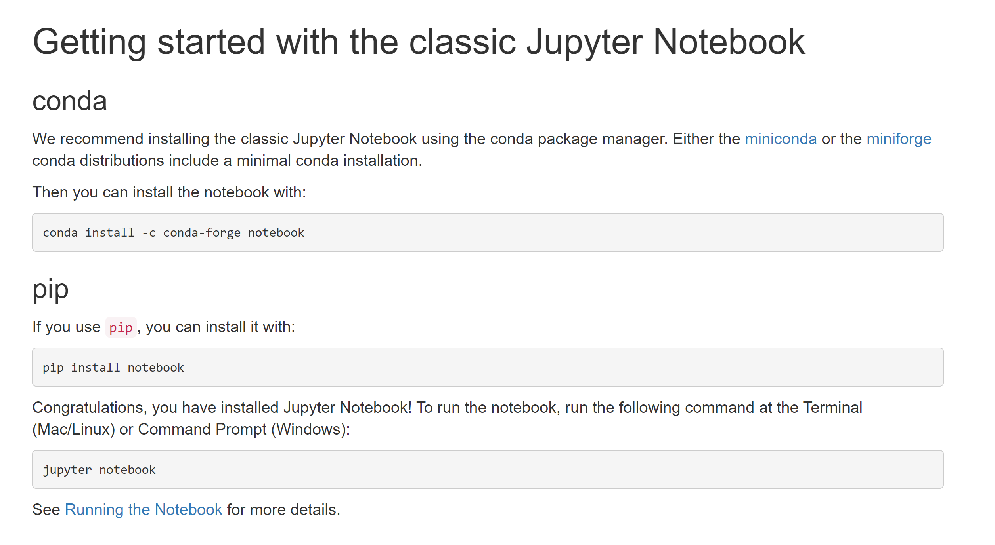
1. Install Jupyter Notebook
This is an exceprt from https://jupyter.org/install.html

Slide 6
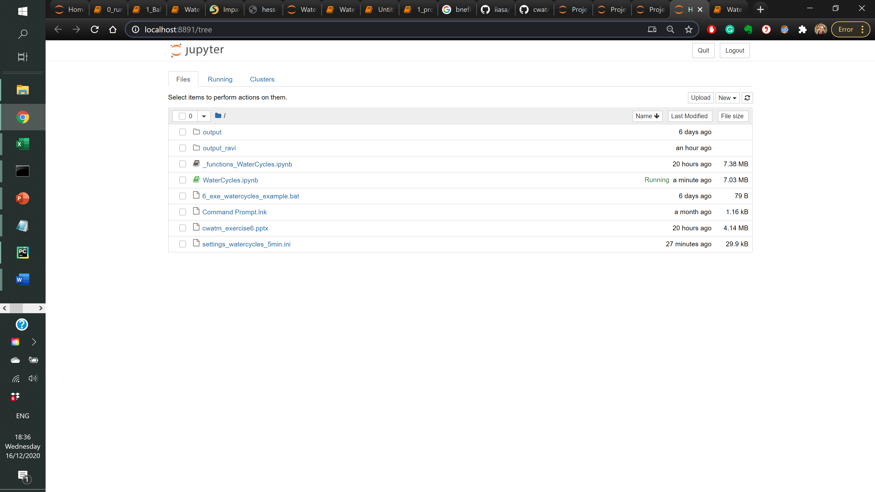
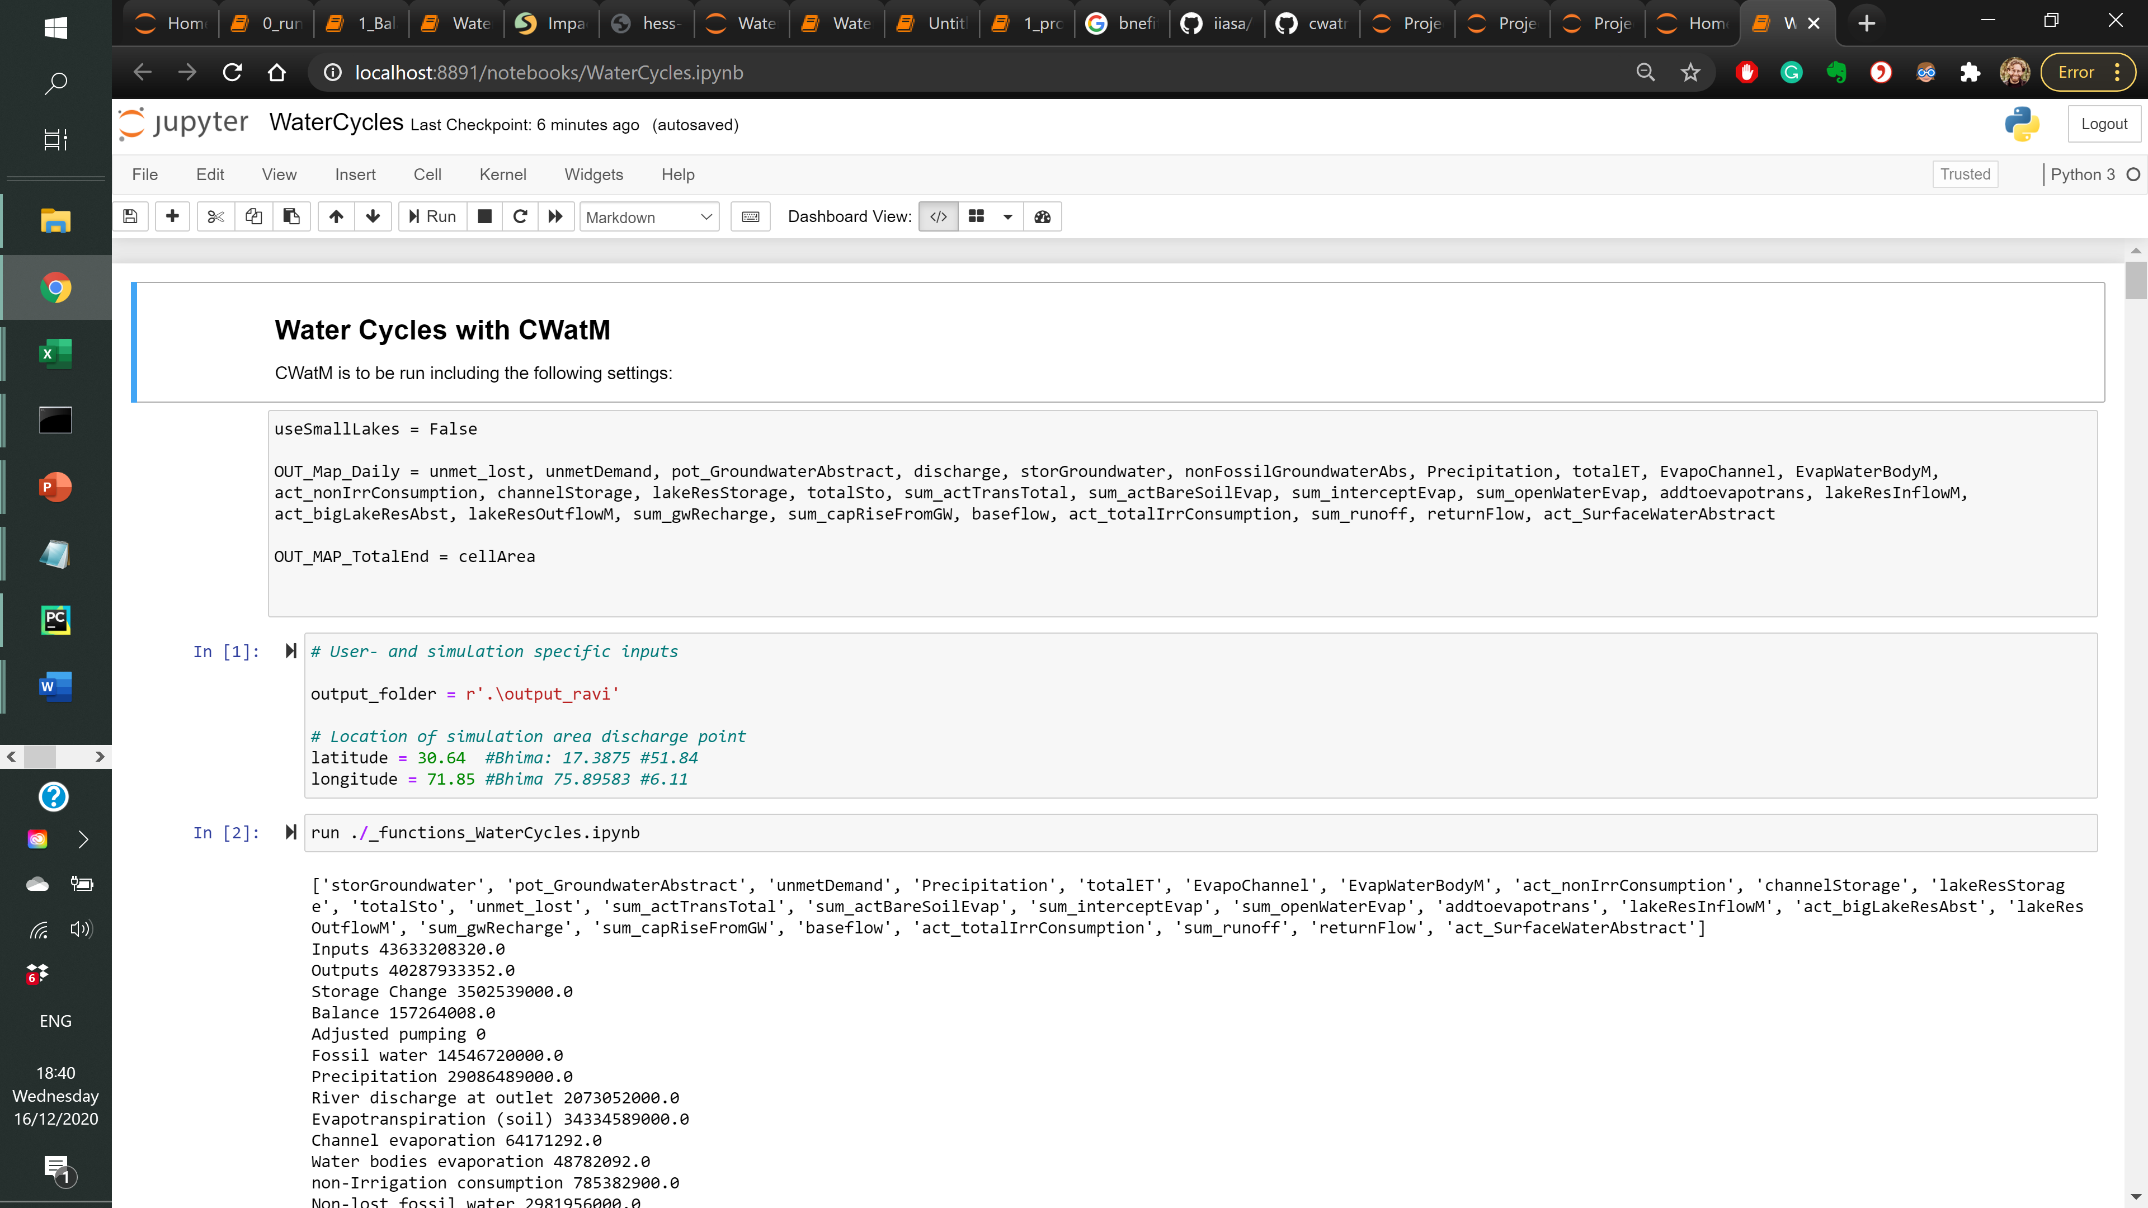
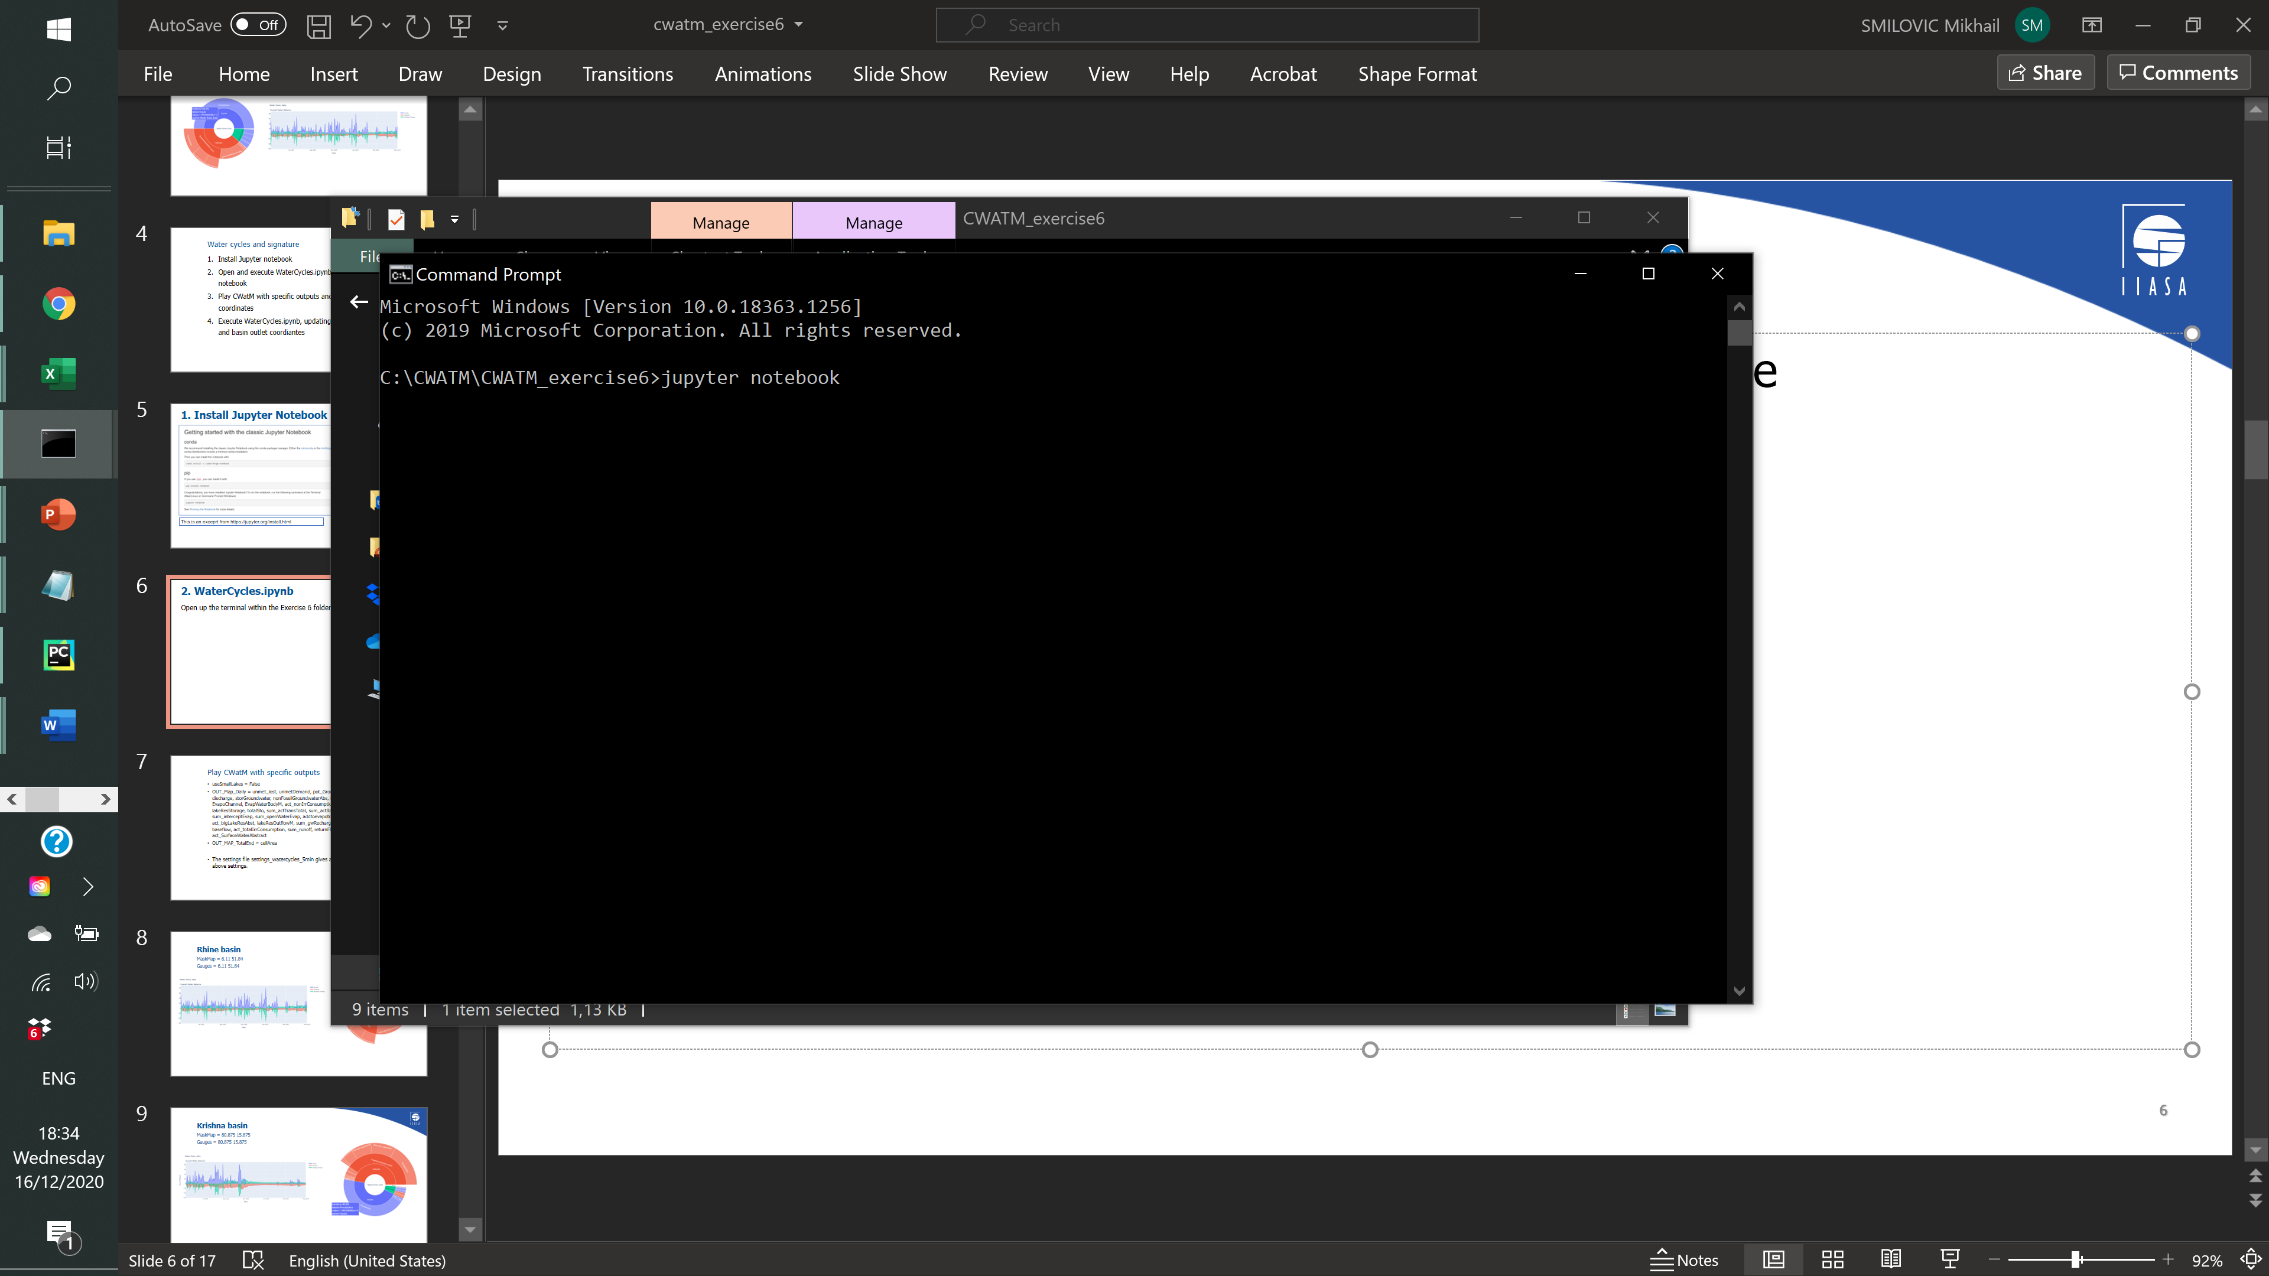
2. WaterCycles.ipynb
Open up the terminal within the Exercise 6 folder and type
jupyter notebook
Click WaterCycles.ipynb
Execute the notebook

Slide 7
3. Play CWatM with these settings
Bring your settings file from exercise 5 into the exercise 6 folder, and include the following settings:
PathOut = ./output
useSmallLakes = False
OUT_Map_Daily = unmet_lost, unmetDemand, pot_GroundwaterAbstract, discharge, storGroundwater, nonFossilGroundwaterAbs, Precipitation, totalET, EvapoChannel, EvapWaterBodyM, act_nonIrrConsumption, channelStorage, lakeResStorage, totalSto, sum_actTransTotal, sum_actBareSoilEvap, sum_interceptEvap, sum_openWaterEvap, addtoevapotrans, lakeResInflowM, act_bigLakeResAbst, lakeResOutflowM, sum_gwRecharge, sum_capRiseFromGW, baseflow, act_totalIrrConsumption, sum_runoff, returnFlow, act_SurfaceWaterAbstract
OUT_MAP_TotalEnd = cellArea
Alternatively, the settings file settings_watercycles_5min.ini already has the correct settings. Simply change MaskMap and Gauges to the coordinates of the outlet of any basin of interest.
For example, for the Nile basin
MaskMap = 30.45 31.4
Gauges = 30.45 31.4

Slide 8
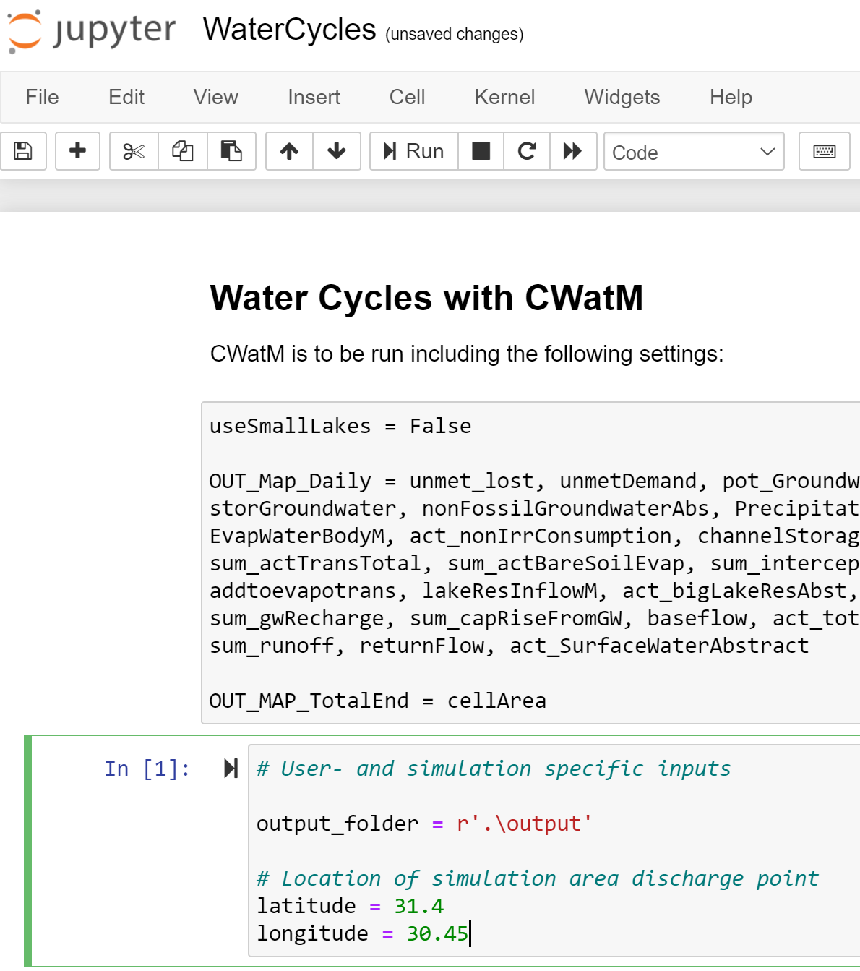
4. WaterCycles, new basin
Update the output folder and the coordinates to the assocaited basin outlet, and then execute!
output_folder = r’.\output’

Slide 9
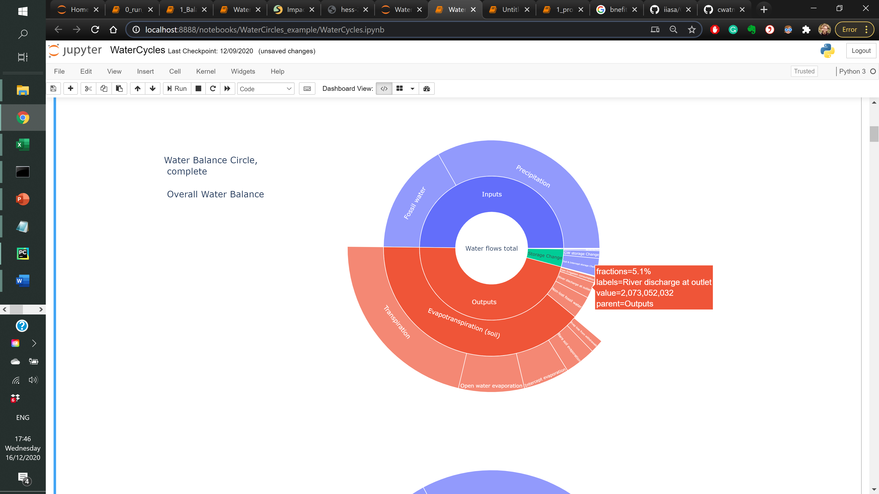
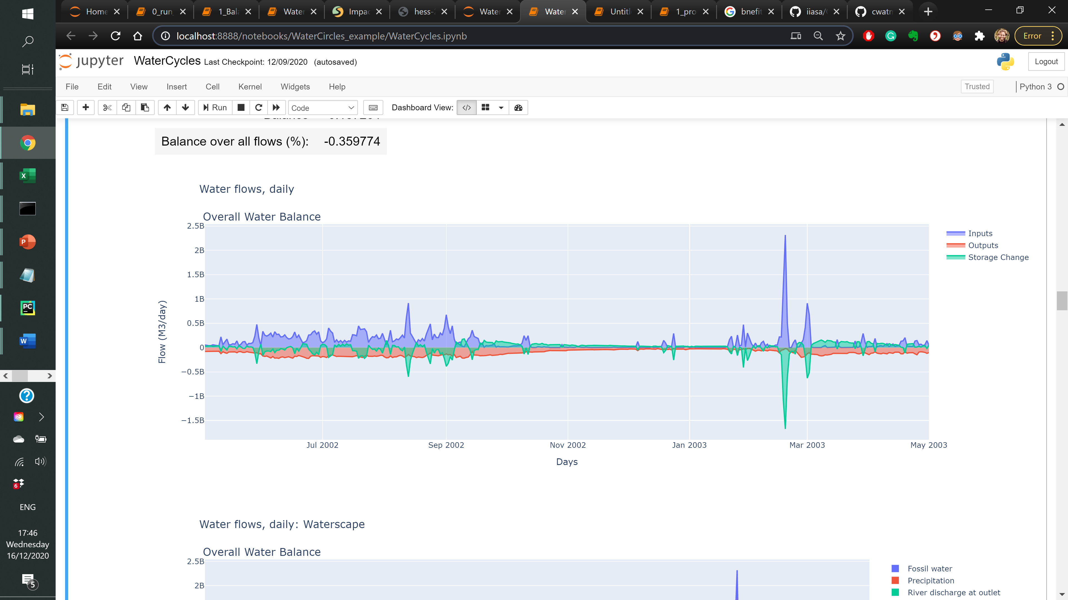
Ravi subbasin
MaskMap = 71.85 30.64 (long lat) Gauges = 71.85 30.64 (long lat)
StepStart = 01/04/2002
SpinUp = 01/05/2002
StepEnd = 01/05/2003

Slide 10
Rhine basin
MaskMap = 6.11 51.84
Gauges = 6.11 51.84
StepStart = 01/04/2002
SpinUp = 01/05/2002
StepEnd = 01/05/2003

Slide 11
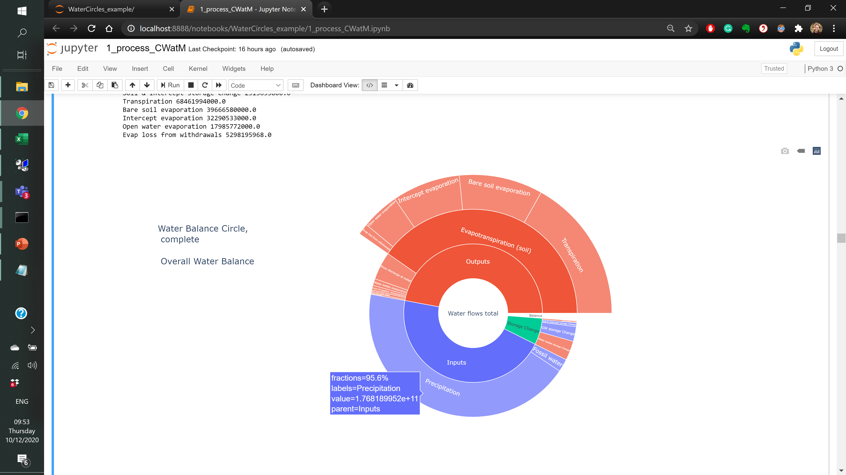
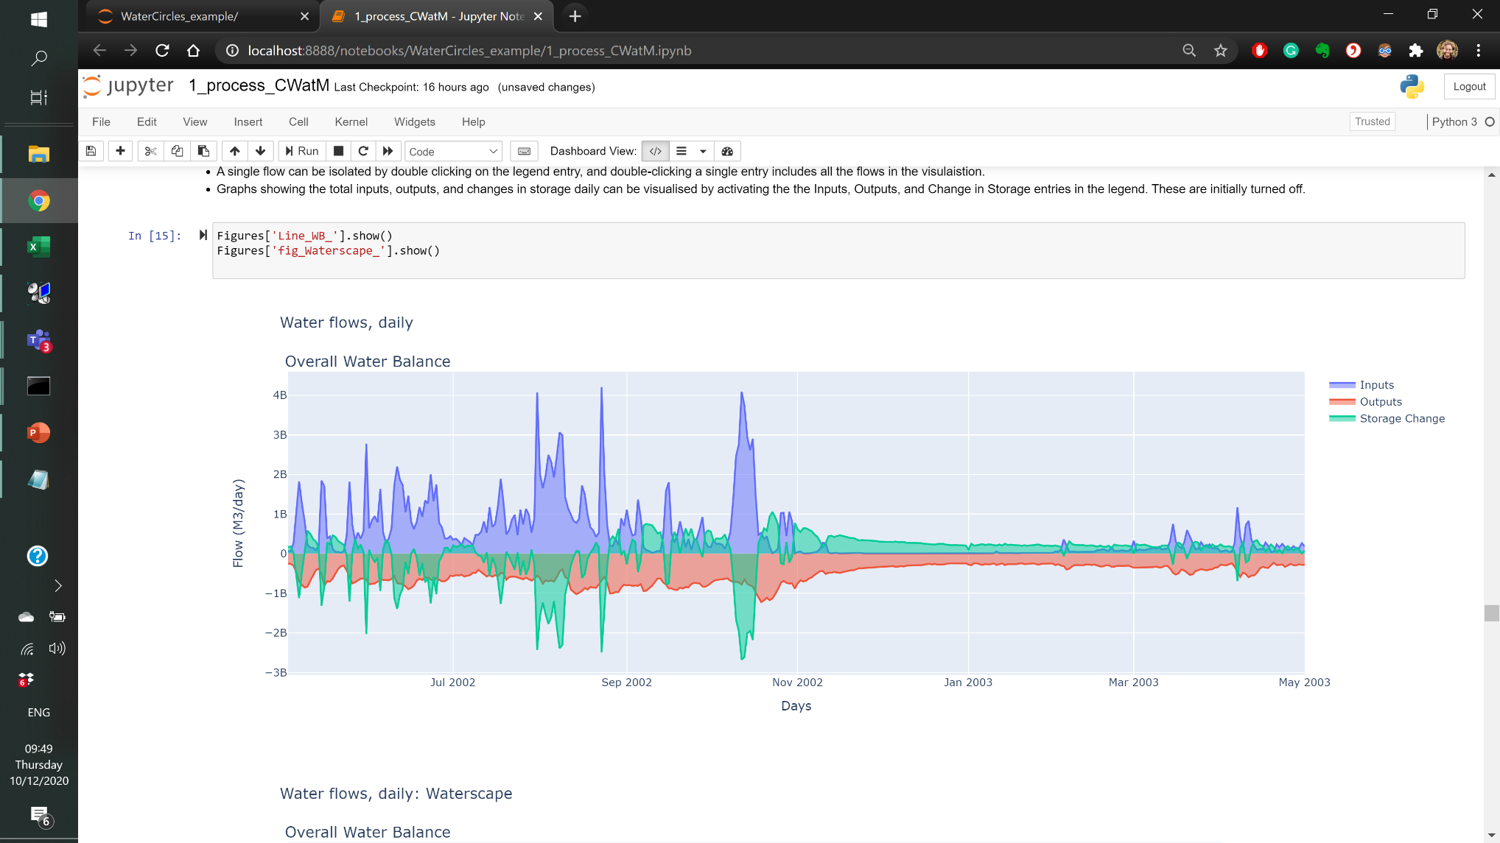
Krishna basin
MaskMap = 80.875 15.875 Gauges = 80.875 15.875
StepStart = 01/04/2002
SpinUp = 01/05/2002
StepEnd = 01/05/2003

Slide 12
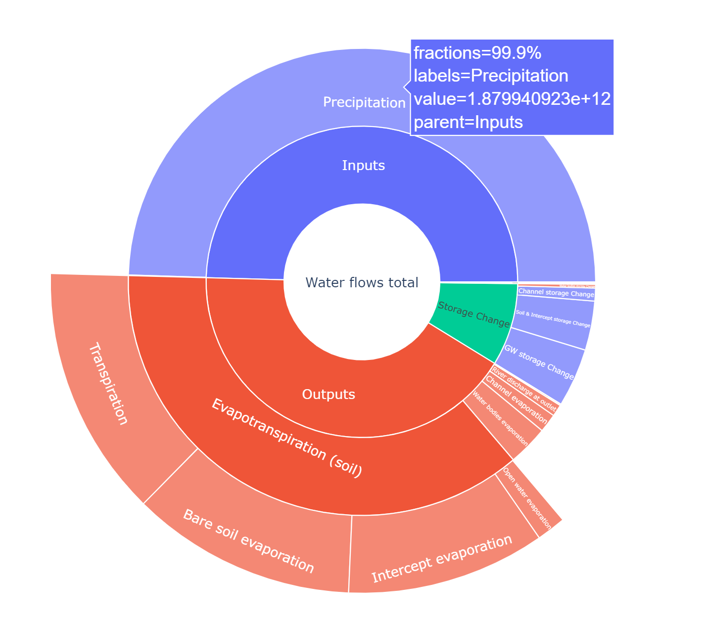
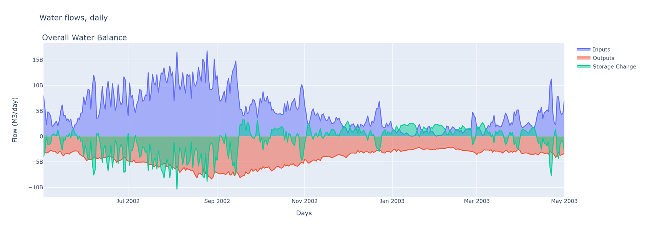
Nile basin
MaskMap = 30.45 31.4 Gauges = 30.45 31.4
StepStart = 01/04/2002
SpinUp = 01/05/2002
StepEnd = 01/05/2003

